Slide 1
Introduction to Iteration

Slide 2
Today
Look at a core concept of programming called iteration
Extend Python programming skills

Slide 3
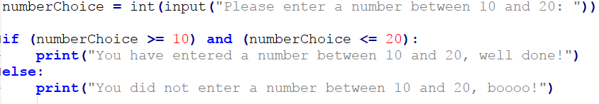
How many conditions have to be true for the if statement code to run?
What is so important about the : and indentation in this Python code?

Slide 4
Iteration
So far we have covered two of the three key programming concepts of:
Sequence
Selection
Iteration
We will now look at the third – iteration
Iteration is also know as looping
There are two key types of loop in Python:
While
For

Slide 5
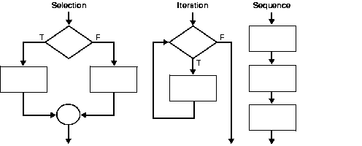

Slide 6
While Loop
The while keyword creates a loop
A condition is checked and while it is true the loop runs.
Let’s look at an example…

Slide 7
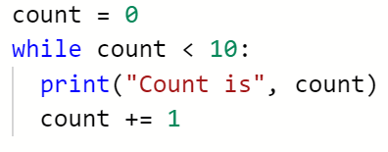
While Loops
What will happen when this code is run?

Slide 8
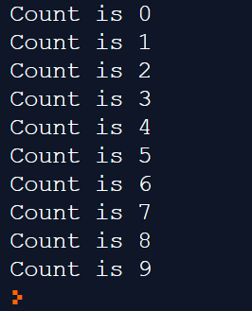
While Loops
What will happen when this code is run?
count = count +1
count += 1
Key word: increment

Slide 9
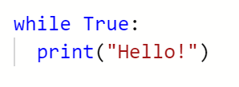
while(True)
What issues can you see with this code?
What will happen when it is run?

Slide 10
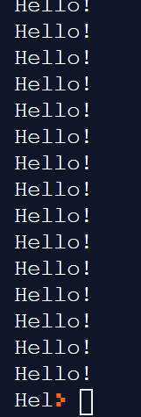
While True
What issues can you see with this code?
What will happen when it is run?
The code will just continually run – usually until the computer crashes (in the old days – now you can ‘break’ out of it)
This type of loop is called an “infinite loop”
There should always be a way in which the loop can be exited…

Slide 11
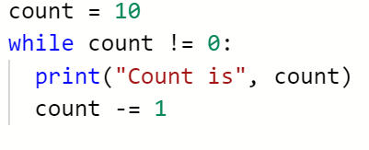
While Loops

Slide 12
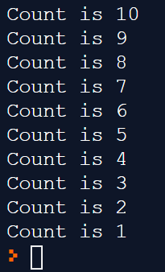
While Loops
The += assignment operator takes the contents of the variable and adds one to it. Increment.
The -= assignment operator takes the contents of the variable and subtracts one from it. Decrement.

Slide 13
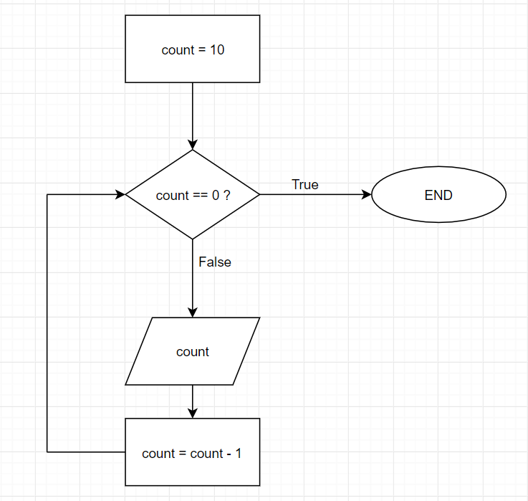
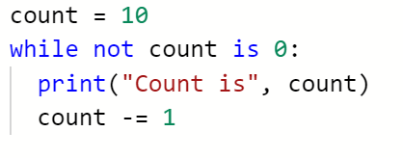
While Loops

Slide 14
For Loops
There is another type of loop that is used in Python…
…it is called a for loop, but…
…we will save that one for a later lecture.

Slide 15
Extension – for those that want the stretch!
Worksheet in OneNote
If you finish that, use the rest of this lesson to work on the Python section of code academy, unless…
Come on up to the front!

Slide 16
While Loops
While loops can be used to ask a user if they wish to run a completed program again.
Think back to the exam grade calculator that we made…
…it could be improved by putting it in a while loop…
…once one grade has been awarded, the program could be used to check the grade of another score.
Let’s take a look…

Slide 17
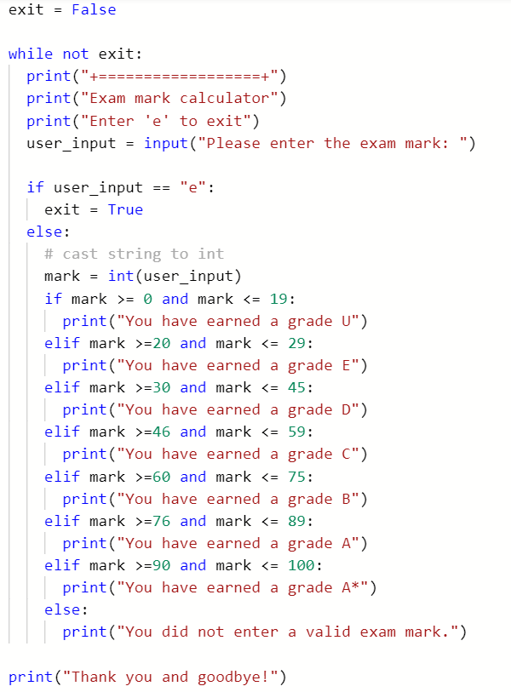
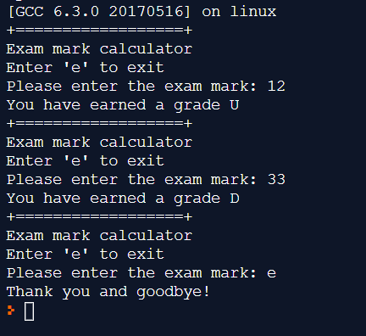
https://repl.it/@JohnGlazebrook/while-loops-student-grades

Slide 18
Task
Write a program to control the temperature of a fish tank
Monitor the temperature
When the temp drops below 24 deg C apply heat
When the temp is above 27 deg C stop applying heat
Simulate the temperature. Temperature will drop 1 deg every 5 seconds

